Slide 1

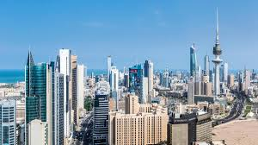
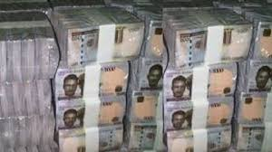


COVID 19: THINKING INVESTMENT AND LIQUIDITY RESILIENCE
Presentation by Roseline O. OLUITAN
Department of Banking & Finance
Faculty of Management Sciences
Lagos State University

Slide 2
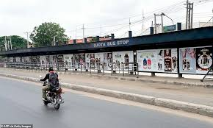


COVID 19 Synopsis: Is Nigeria Resilient to the Pandemic?
The world is presently going through a contagion i.e. COVID-19 that result in shifts in government priorities
Response - economies were shut down with evidence in the speed of global interconnectedness of human risk factors, and fragility to crises.
Countries depend on investment in resilient sectors and reserves along with donations.
If COVID 19 should last 6 to 12 months, what will be the fate of Nigeria.
Nigeria: - Twin Problem
Other Economic Issues
Financial Intermediation Issues: -
- Investment resilience issues
- Liquidity resilience issues

Slide 3
Sectoral Distribution of Bank Loans – Is Nigeria Investment Resilient?

Slide 4
Are we Liquidity Resilient? – Banked Populace Post Lockdown

Slide 5


Approach
The strength of the banking system may determine its capacity of the economy as well as its reaction to the pandemic.
This presentation examines how adequate investment and liquidity resilience can facilitate quick economic recovery in Nigeria
Examines the situation of Nigeria through a VECM study conducted using data from 1980 to 2018 as current pedestal (Pre COVID -19)
Posits on the essential resilient concepts for sustainability.

Slide 6
VECM RESULT OF INVESTMENT AND LIQUIDITY VECM RESULT OF INVESTMENT AND SECTORS ON GROWTH ON GROWTH
 | Coefficient | Std. Error | t-Statistic | Prob.
C | 1875.53 | 435.73 | 4.3042 | 0.0004
GDP(-1) | 1.0772 | 0.2175 | 4.9512 | 0.0001
GDP(-2) | 0.9005 | 0.2708 | 3.3254 | 0.0038
FDI(-1) | 395.32 | 189.72 | 2.0836 | 0.0517
FDI(-2) | 152.45 | 159.62 | 0.9550 | 0.3522
CPS(-1) | -6.8999 | 1.2849 | -5.3698 | 0.0000
CPS(-2) | -4.4548 | 1.0106 | -4.4077 | 0.0003
SAVINGS(-1) | 4.9664 | 1.1737 | 4.2312 | 0.0005
SAVINGS(-2) | 2.0742 | 0.8143 | 2.5470 | 0.0202
PVT. INV(-1) | 0.0216 | 0.0031 | 6.8209 | 0.0000
PVT. INV(-2) | 0.0096 | 0.0038 | 2.4989 | 0.0224
PUB. INV(-1) | 7.3300 | 1.9794 | 3.7030 | 0.0016
PUB. INV(-2) | 7.4460 | 2.4371 | 3.0552 | 0.0068
MPR(-1) | -157.17 | 71.8527 | -2.1874 | 0.0421
MPR(-2) | -102.71 | 68.4999 | -1.4995 | 0.1511
ECM | -0.6581 | 0.1382 | -4.7596 | 0.0002
 | Coefficient | Std. Error | t-Statistic | Prob.
C | -74.739 | 323.97 | -0.2306 | 0.8194
GDP(-1) | 1.1418 | 0.1087 | 10.497 | 0.0000
FDI(-1) | 52.519 | 192.70 | 0.2725 | 0.7874
SAVINGS(-1) | 1.2678 | 0.6222 | 2.0376 | 0.0523
PRIV-1) | 0.0075 | 0.0040 | 1.8702 | 0.0732
PUIV(-1) | 3.7174 | 2.5709 | 1.4459 | 0.1606
MPR(-1) | -68.769 | 80.720 | -0.8519 | 0.4023
AGRI(-1) | 16.320 | 10.689 | 1.5268 | 0.1393
MANU(-1) | 2.0232 | 4.0292 | 0.5021 | 0.6200
SERVICES(-1) | 0.0040 | 1.3055 | 0.0031 | 0.9975
ECM | -0.0795 | 0.0294 | -2.7032 | 0.0122

Slide 7

Conclusion
Public investment is stronger than private investment for now.
A shift from public-led that cannot support sustainable development.
Savings is an important driver of growth and potent source of liquidity that banks can leverage on for intermediation purposes.
Nigeria should restrategise to be able to withstand shocks and uncertainties hence recommend as follows

Slide 8



Recommendations
The government must ensure policies that redirect investment to the resilient sectors of the economy, which will support the much desired diversification of the economy.
Efforts should be made to create value chain for raw products found in this country.
Private establishments require long term funds for their businesses. Banks should assist – Need for long term fund.
Banking service should be endeared to the public for acceptance so as to reduce the level of the unbanked populace. Current agent banking good initiative.

Slide 9
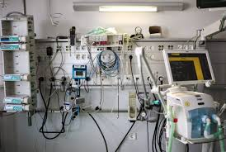
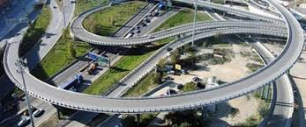
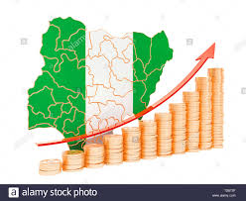
Recommendations
The government needs to refocus and restrategise to be an unbiased umpire through policy direction that provides enabling environment for private institutions to thrive and be globally competitive. Create giant institutions
The Central Bank of Nigeria must ensure and maintain appropriate spread between MPR, TB rate and lending rate, single digit lending rate is not impossible.
Wealth redistribution through full adoption of the minimum wage and other social security programmes that will reduce poverty and also increase the savings rate of the public
The security level within the country should be improved. Ditto for other investment climate criteria like ease of doing business, level of corruption etc.

Slide 10


Slide 11


